Slide 1

Springboard Capstone Project One Predicting Taxi Ride Duration in NYC
Author: Anshul Dikshit
Date: September 16, 2018

Slide 2

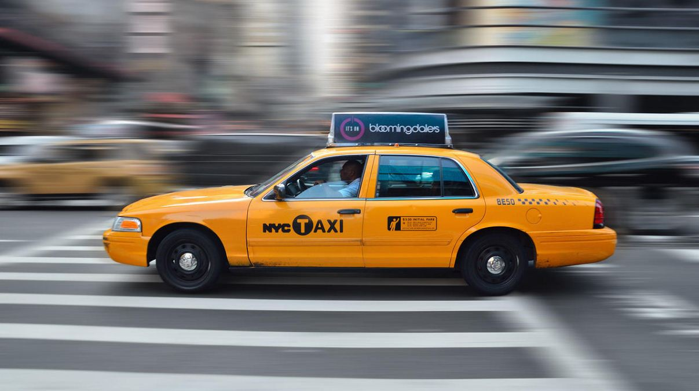
Outline
Introduction & Problem Statement
Dataset
Analysis & Findings
Statistical Inference
Machine Learning
Conclusions

Slide 3
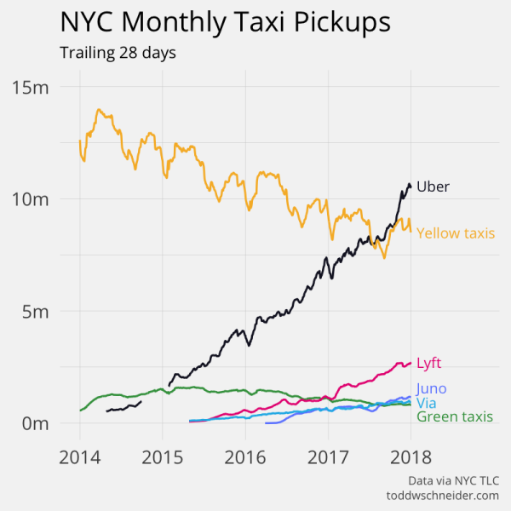
Introduction & PROBLEM STATEMENT
With almost 1.5 million trips in 2016, riding through taxi at any time of the year across New York City is a big deal.
THE PROBLEM
Given the increase in number of taxi rides in NYC in recent years, there needs to be an estimates of taxi trip durations can improve the taxi utilization and the satisfaction of drivers and passengers

Slide 4
Data Set
Test dataset:
Variable name | Variable description
id | A unique identifier for each trip
vendor_id | A code indicating the provider associated with the trip record
pickup_datetime | Date and time when the meter was engaged
passenger_count | The number of passengers in the vehicle (driver entered value)
pickup_longitude | The longitude where the meter was engaged
pickup_latitude | The latitude where the meter was engaged
dropoff_longitude | The longitude where the meter was disengaged
dropoff_latitude | The latitude where the meter was disengaged
store_and_fwd_flag | This flag indicates whether the trip record was held in vehicle memory before sending to the vendor because the vehicle did not have a connection to the server.
 | Y=store and forward; N=not a store and forward trip
The data has been taken from Kaggle which provides a starting point dataset consisting of the records of ~1.5 million taxi trips that took place in 2016. I’ve tried to go through the process of understanding the individual variables in the data by presenting beautiful, clear, and interactive data visualizations along with some approaches to their interpretation
Train dataset:
Variable name | Variable description
id | A unique identifier for each trip
vendor_id | A code indicating the provider associated with the trip record
pickup_datetime | Date and time when the meter was engaged
dropoff_datetime | Date and time when the meter was disengaged
passenger_count | The number of passengers in the vehicle (driver entered value)
pickup_longitude | The longitude where the meter was engaged
pickup_latitude | The latitude where the meter was engaged
dropoff_longitude | The longitude where the meter was disengaged
dropoff_latitude | The latitude where the meter was disengaged
store_and_fwd_flag | This flag indicates whether the trip record was held in vehicle memory before sending to the vendor because the vehicle did not have a connection to the server.
 | Y=store and forward; N=not a store and forward trip
trip_duration | Duration of the trip in seconds

Slide 5
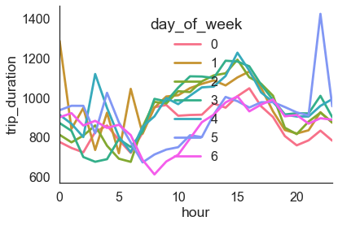
Initial Analysis
On day 0, that is Sunday and day 6 that is Saturday, the trip duration is very less that all the weekdays at 5 AM to 15 AM time. See this, on Saturday around midnight, the rides are taking far more than usual time, this is obvious through now verified using given data

Slide 6
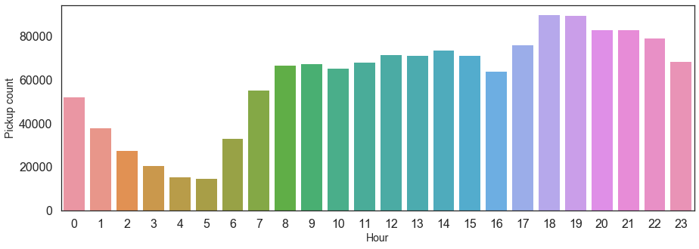
Initial Analysis (cont.)
How many pickups/hr
As expected, the number of pickups gradually decreases after mid-night. The highest number of pickups are around 6pm and 7pm in the evening which makes sense as many people are on their way to home from office.

Slide 7
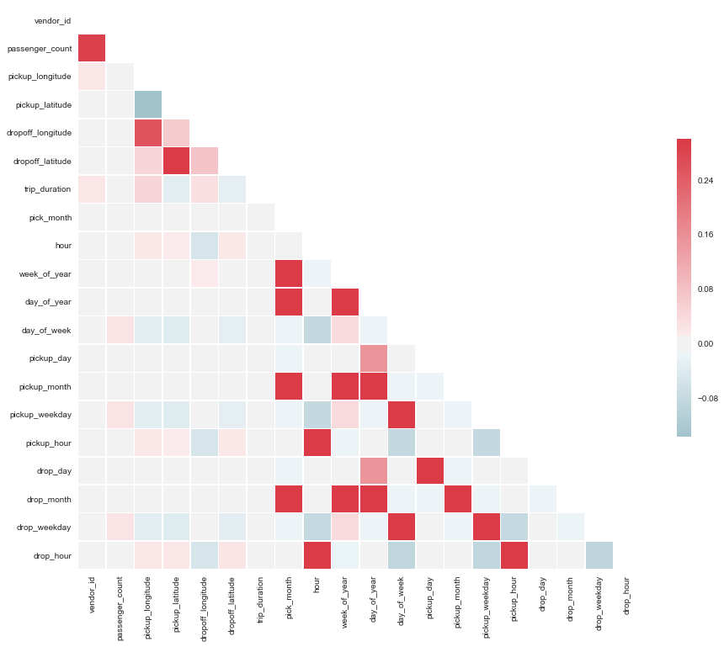
Correlation between the different variables
The highest correlation is observed with the gollowing variables:
Week_of_year and pick_month
day_of_year and pick_month
trip_duration and pickup_longitude

Slide 8
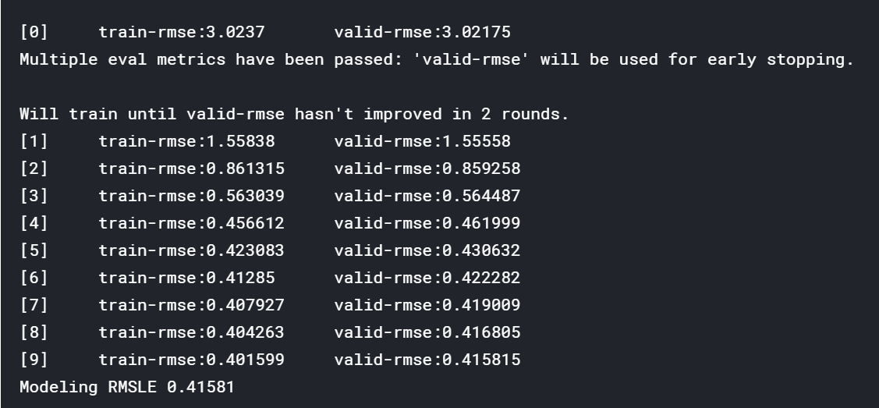
Training and testing the model using XGBoost

